Slide 1
Cybersecurity and Block Chain
Prepared by: Dr. Anish Pandey

Slide 2
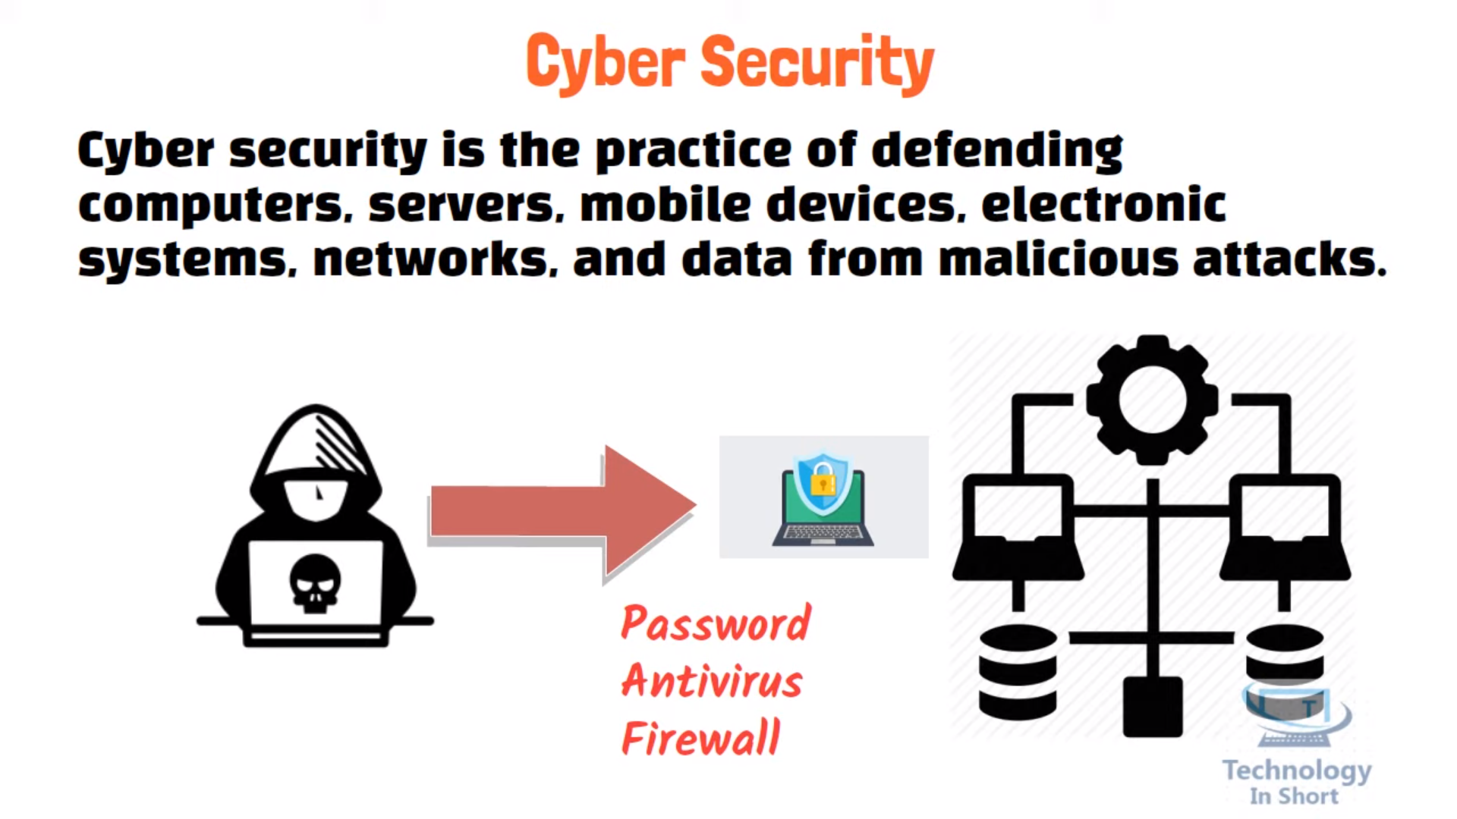
Notes:
First picture shows and embedded system for a washing machine, it connects with physical devices such as button switches for taking user input, and motors for driving the wash tub.
Similarly, second figure shows a simple embedded system for switching a device on/off wirelessly.

Slide 3
About Cybersecurity
We can divide cybersecurity into two parts one is cyber, and the other is security. Cyber refers to the technology that includes systems, networks, programs, and data.
And security is concerned with the protection of systems, networks, applications, and information. In some cases, it is also called electronic information security or information technology security.
Cybersecurity refers to any technology, measure or practice for preventing cyberattacks or mitigating their impact.
Cybersecurity is the protection of internet-connected systems such as hardware, software and data from cyber threats.
Cybersecurity aims to protect individuals’ and organizations’ systems, applications, computing devices, sensitive data and financial assets against simple and annoying computer viruses, sophisticated and costly ransomware attacks, and everything in between.
The need for secure, reliable connections is of utmost importance to prevent smart factory information and manufacturing lines from cyber threats.
Notes:
Before understanding Cyber physical systems, the reader must understand what is an embedded system.
The Industrial Internet has come about due to the rapid advancements in digital computers in all their formats and vast improvements in digital communications. These disciplines are considered separate domains of knowledge and expertise, with there being a tendency for specialization in one or the other. This results in inter-disciplinary knowledge being required to design and build products that require information processing and networking; for example, a device with embedded microprocessor and ZigBee, such as the Raspberry Pi or a smartphone. However, when we start to interact with the physical world, we have a physical domain to contend with and that requires special knowledge of that physical and mechanical domain such as that of a mechanical engineer. Therefore, it is necessary to identify early in the design process whether the product is to be an IT, network, or a physical system–or a system that has all three, physical, network, and digital processing features. If it has, then it is said to be a cyber-physical system. In some definitions, the networking and communications feature is deemed optional, although that raises the question as to how a CPS differs from an embedded system.

Slide 4
Due to demand for better Internet connectivity and communication protocols in Industry 4.0, there is a need to secure and protect industrial data processing systems from hackers and other cyber security threats.
The following are the system that can be affected by security breaches and attacks:
Communication: Cyber attackers can use phone calls, emails, text messages, and messaging apps for cyberattacks.
Finance: This system deals with the risk of financial information like bank and credit card detail. This information is naturally a primary target for cyber attackers.
Governments: The cybercriminal generally targets the government institutions like defence, finance, etc. to get confidential public data or private citizen information.
Transportation: In this system, cybercriminals generally target connected cars, traffic control systems, and smart road infrastructure.
Healthcare: A cybercriminal targets the healthcare system to get the information stored at a local clinic to critical care systems at a national hospital.
Education: A cybercriminals target educational institutions to get their confidential research data and information of students and employees.
Notes:
First picture shows and embedded system for a washing machine, it connects with physical devices such as button switches for taking user input, and motors for driving the wash tub.
Similarly, second figure shows a simple embedded system for switching a device on/off wirelessly.

Slide 5
Why is cybersecurity important?
In today’s connected world, everyone benefits from advanced cyberdefense programs. At an individual level, a cybersecurity attack can result in everything from identity theft, to extortion attempts, to the loss of important data like family photos.
Everyone relies on critical infrastructure like power plants, hospitals, and financial service companies. Securing these and other organizations is essential to keeping our society functioning.
Types of cyber threats
The threats countered by cyber-security are three-fold:
Cybercrime includes single actors or groups targeting systems for financial gain or to cause disruption.
Cyber-attack often involves politically motivated information gathering.
Cyberterrorism is intended to undermine electronic systems to cause panic or fear.
Notes:
First picture shows and embedded system for a washing machine, it connects with physical devices such as button switches for taking user input, and motors for driving the wash tub.
Similarly, second figure shows a simple embedded system for switching a device on/off wirelessly.

Slide 6
Types of cybersecurity threats
Phishing is the practice of sending fraudulent emails that resemble emails from reputable sources. The aim is to steal sensitive data like credit card numbers and login information. It’s the most common type of cyber attack. You can help protect yourself through education or a technology solution that filters malicious emails.
Social engineering is an attack that relies on human interaction. It tricks users into breaking security procedures to gain sensitive information that is typically protected.
Ransomware is a type of malicious software. It is designed to extort money by blocking access to files or the computer system until the ransom is paid. Paying the ransom does not guarantee that the files will be recovered or the system restored.
Malware is a type of software designed to gain unauthorized access or to cause damage to a computer. Examples of malware include Virus, Trojans, Spyware, etc.
Notes:
First picture shows and embedded system for a washing machine, it connects with physical devices such as button switches for taking user input, and motors for driving the wash tub.
Similarly, second figure shows a simple embedded system for switching a device on/off wirelessly.

Slide 7
What are different types of cyber security?
Network security: It involves implementing the hardware and software to secure a computer network from unauthorized access, intruders, attacks, disruption, and misuse. This security helps an organization to protect its assets against external and internal threats.
Cloud security: Cloud security is concerned with securing data, applications, and infrastructure in the Cloud.
IoT (Internet of Things) security: IoT security involves securing smart devices and networks connected to the IoT. IoT devices include things that connect to the Internet without human intervention, such as smart fire alarms, lights, thermostats, and other appliances.
Application security: It involves protecting the software and devices from unwanted threats. This protection can be done by constantly updating the apps to ensure they are secure from attacks.
Notes:
First picture shows and embedded system for a washing machine, it connects with physical devices such as button switches for taking user input, and motors for driving the wash tub.
Similarly, second figure shows a simple embedded system for switching a device on/off wirelessly.

Slide 8
Cyber safety tips - protect yourself against cyberattacks
Update your software and operating system: This means you benefit from the latest security patches.
Use anti-virus software: Security solutions like Kaspersky Total Security will detect and removes threats. Keep your software updated for the best level of protection.
Use strong passwords: Ensure your passwords are not easily guessable.
Do not open email attachments from unknown senders: These could be infected with malware.
Do not click on links in emails from unknown senders or unfamiliar websites: This is a common way that malware is spread.
Avoid using unsecure Wi-Fi networks in public places: Unsecure networks leave you vulnerable to man-in-the-middle attacks.
Notes:
First picture shows and embedded system for a washing machine, it connects with physical devices such as button switches for taking user input, and motors for driving the wash tub.
Similarly, second figure shows a simple embedded system for switching a device on/off wirelessly.

Slide 9
What are the benefits of cybersecurity?
The benefits of implementing and maintaining cybersecurity practices include:
Business protection against cyberattacks and data breaches.
Protection for data and networks.
Prevention of unauthorized user access.
Protection for end users and endpoint devices.
Improved confidence in the company's reputation and trust for developers, partners, customers, stakeholders and employees.
Notes:
First picture shows and embedded system for a washing machine, it connects with physical devices such as button switches for taking user input, and motors for driving the wash tub.
Similarly, second figure shows a simple embedded system for switching a device on/off wirelessly.

Slide 10
Block Chain

Slide 11
Blockchain Overview
Blockchain technology is a decentralized, distributed ledger that stores the record of ownership of digital assets.
Blockchain is a shared, immutable ledger that facilitates the process of recording transactions and tracking assets in a business network.
An asset can be tangible (a house, car, cash, land) or intangible (intellectual property, patents, copyrights, branding).
A blockchain is a digital database that stores records in chronological order. Information on a blockchain is kept in “blocks” linked to one another on a “chain” through shared mathematical algorithms.
Blocks contain data, usually transaction records, including the sender and receiver of a transaction, a timestamp and the amount and type of currency sent.
Notes:
Before understanding Cyber physical systems, the reader must understand what is an embedded system.
The Industrial Internet has come about due to the rapid advancements in digital computers in all their formats and vast improvements in digital communications. These disciplines are considered separate domains of knowledge and expertise, with there being a tendency for specialization in one or the other. This results in inter-disciplinary knowledge being required to design and build products that require information processing and networking; for example, a device with embedded microprocessor and ZigBee, such as the Raspberry Pi or a smartphone. However, when we start to interact with the physical world, we have a physical domain to contend with and that requires special knowledge of that physical and mechanical domain such as that of a mechanical engineer. Therefore, it is necessary to identify early in the design process whether the product is to be an IT, network, or a physical system–or a system that has all three, physical, network, and digital processing features. If it has, then it is said to be a cyber-physical system. In some definitions, the networking and communications feature is deemed optional, although that raises the question as to how a CPS differs from an embedded system.

Slide 12
A simple analogy for how blockchain technology operates can be compared to how a Google Docs document works. When you create a Google Doc and share it with a group of people, the document is simply distributed instead of copied or transferred.
This creates a decentralized distribution chain that gives everyone access to the base document at the same time. No one is locked out awaiting changes from another party, while all modifications to the document are being recorded in real-time, making changes completely transparent.
A significant gap to note however is that unlike Google Docs, original content and data on the blockchain cannot be modified once written, adding to its level of security.
Notes:
First picture shows and embedded system for a washing machine, it connects with physical devices such as button switches for taking user input, and motors for driving the wash tub.
Similarly, second figure shows a simple embedded system for switching a device on/off wirelessly.

Slide 13
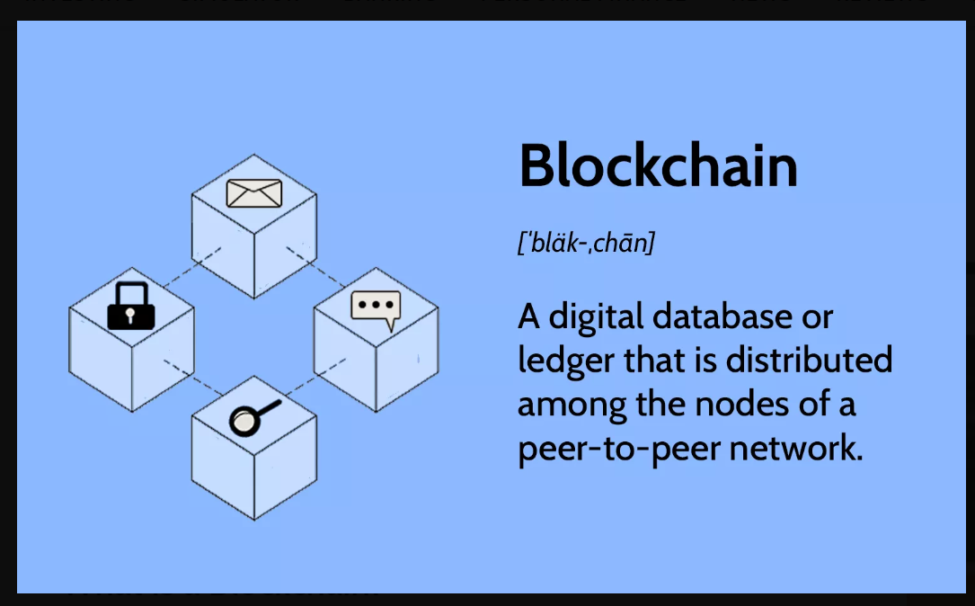
Notes:
First picture shows and embedded system for a washing machine, it connects with physical devices such as button switches for taking user input, and motors for driving the wash tub.
Similarly, second figure shows a simple embedded system for switching a device on/off wirelessly.

Slide 14
Key elements of a blockchain
Distributed ledger technology: - All network participants have access to the distributed ledger and its immutable record of transactions. With this shared ledger, transactions are recorded only once, eliminating the duplication of effort that’s typical of traditional business networks.
Immutable records: - No participant can change or tamper with a transaction after it’s been recorded to the shared ledger. If a transaction record includes an error, a new transaction must be added to reverse the error, and both transactions are then visible.
Smart contracts: - To speed transactions, a set of rules — called a smart contract — is stored on the blockchain and executed automatically. A smart contract can define conditions for corporate bond transfers.
Notes:
Before understanding Cyber physical systems, the reader must understand what is an embedded system.
The Industrial Internet has come about due to the rapid advancements in digital computers in all their formats and vast improvements in digital communications. These disciplines are considered separate domains of knowledge and expertise, with there being a tendency for specialization in one or the other. This results in inter-disciplinary knowledge being required to design and build products that require information processing and networking; for example, a device with embedded microprocessor and ZigBee, such as the Raspberry Pi or a smartphone. However, when we start to interact with the physical world, we have a physical domain to contend with and that requires special knowledge of that physical and mechanical domain such as that of a mechanical engineer. Therefore, it is necessary to identify early in the design process whether the product is to be an IT, network, or a physical system–or a system that has all three, physical, network, and digital processing features. If it has, then it is said to be a cyber-physical system. In some definitions, the networking and communications feature is deemed optional, although that raises the question as to how a CPS differs from an embedded system.

Slide 15
How does blockchain work?
Blocks in a blockchain contain more than transaction data, they also have what’s known as a hash. Cryptographic hash functions, or hashes, are the mathematical algorithms. These fulfill a crucial role within blockchain systems and are the reason blockchain works in the first place.
Hashes appear as a variable series of numbers and letters on a block, such as 4760RFLG07LDD492K8381O82P78C29QWMN02C1051B6624E99. This number-letter combination is generated from the data within a block and functions as its digital signature.
Each block includes the hash of the previous block in its chain. This is how blocks are linked together and how blockchain networks maintain their integrity. Modifying any content within a block would change the hash, which is a red flag for others in the network.
Put it all together, and you get a self-regulated network without intermediaries, where third parties cannot monitor or interfere with transactions.
Notes:
Before understanding Cyber physical systems, the reader must understand what is an embedded system.
The Industrial Internet has come about due to the rapid advancements in digital computers in all their formats and vast improvements in digital communications. These disciplines are considered separate domains of knowledge and expertise, with there being a tendency for specialization in one or the other. This results in inter-disciplinary knowledge being required to design and build products that require information processing and networking; for example, a device with embedded microprocessor and ZigBee, such as the Raspberry Pi or a smartphone. However, when we start to interact with the physical world, we have a physical domain to contend with and that requires special knowledge of that physical and mechanical domain such as that of a mechanical engineer. Therefore, it is necessary to identify early in the design process whether the product is to be an IT, network, or a physical system–or a system that has all three, physical, network, and digital processing features. If it has, then it is said to be a cyber-physical system. In some definitions, the networking and communications feature is deemed optional, although that raises the question as to how a CPS differs from an embedded system.

Slide 16
Why blockchain is important?
Business runs on information. The faster it’s received and the more accurate it is, the better.
Blockchain is ideal for delivering that information because it provides immediate, shared and completely transparent information stored on an immutable ledger that can be accessed only by permissioned network members.
A blockchain network can track orders, payments, accounts, production and much more. And because members share a single view of the truth, you can see all details of a transaction end to end, giving you greater confidence, as well as new efficiencies and opportunities.
Notes:
Before understanding Cyber physical systems, the reader must understand what is an embedded system.
The Industrial Internet has come about due to the rapid advancements in digital computers in all their formats and vast improvements in digital communications. These disciplines are considered separate domains of knowledge and expertise, with there being a tendency for specialization in one or the other. This results in inter-disciplinary knowledge being required to design and build products that require information processing and networking; for example, a device with embedded microprocessor and ZigBee, such as the Raspberry Pi or a smartphone. However, when we start to interact with the physical world, we have a physical domain to contend with and that requires special knowledge of that physical and mechanical domain such as that of a mechanical engineer. Therefore, it is necessary to identify early in the design process whether the product is to be an IT, network, or a physical system–or a system that has all three, physical, network, and digital processing features. If it has, then it is said to be a cyber-physical system. In some definitions, the networking and communications feature is deemed optional, although that raises the question as to how a CPS differs from an embedded system.

Slide 17
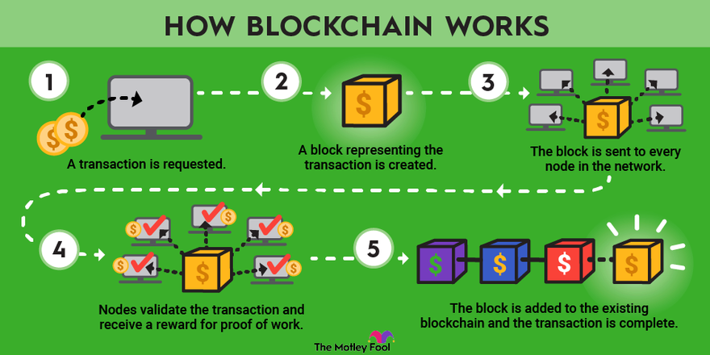
Notes:
First picture shows and embedded system for a washing machine, it connects with physical devices such as button switches for taking user input, and motors for driving the wash tub.
Similarly, second figure shows a simple embedded system for switching a device on/off wirelessly.

Slide 18
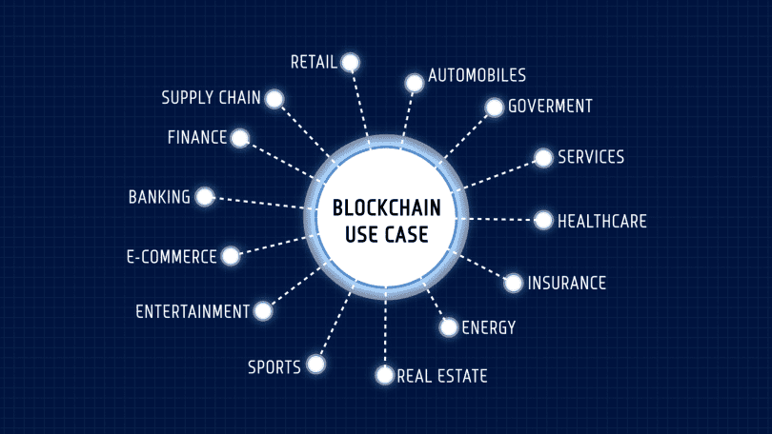
Blockchain Applications
Notes:
First picture shows and embedded system for a washing machine, it connects with physical devices such as button switches for taking user input, and motors for driving the wash tub.
Similarly, second figure shows a simple embedded system for switching a device on/off wirelessly.

